Slide 1

Notes:
ts Created by https://github.com/ekalinin/github-markdown-toc Added by: ardem, at: lun. 18 mars 2024 17:23:33 CET te

Slide 2


Slide 3


Slide 4
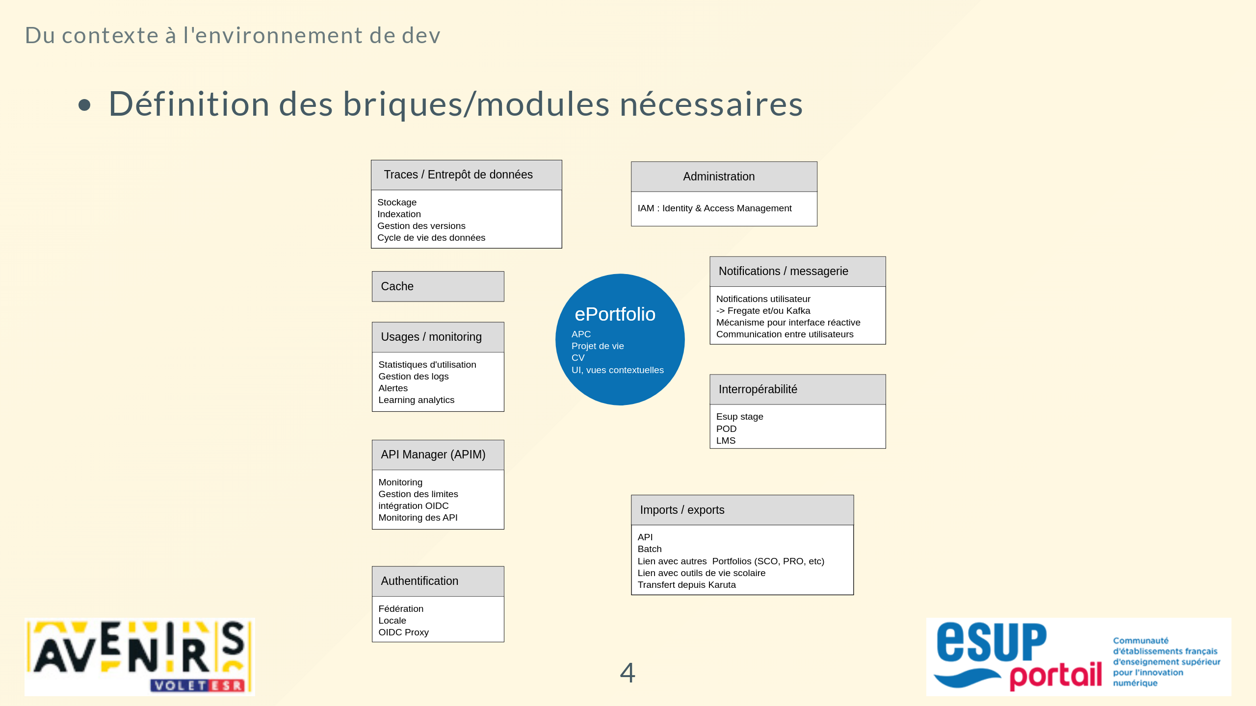

Slide 5
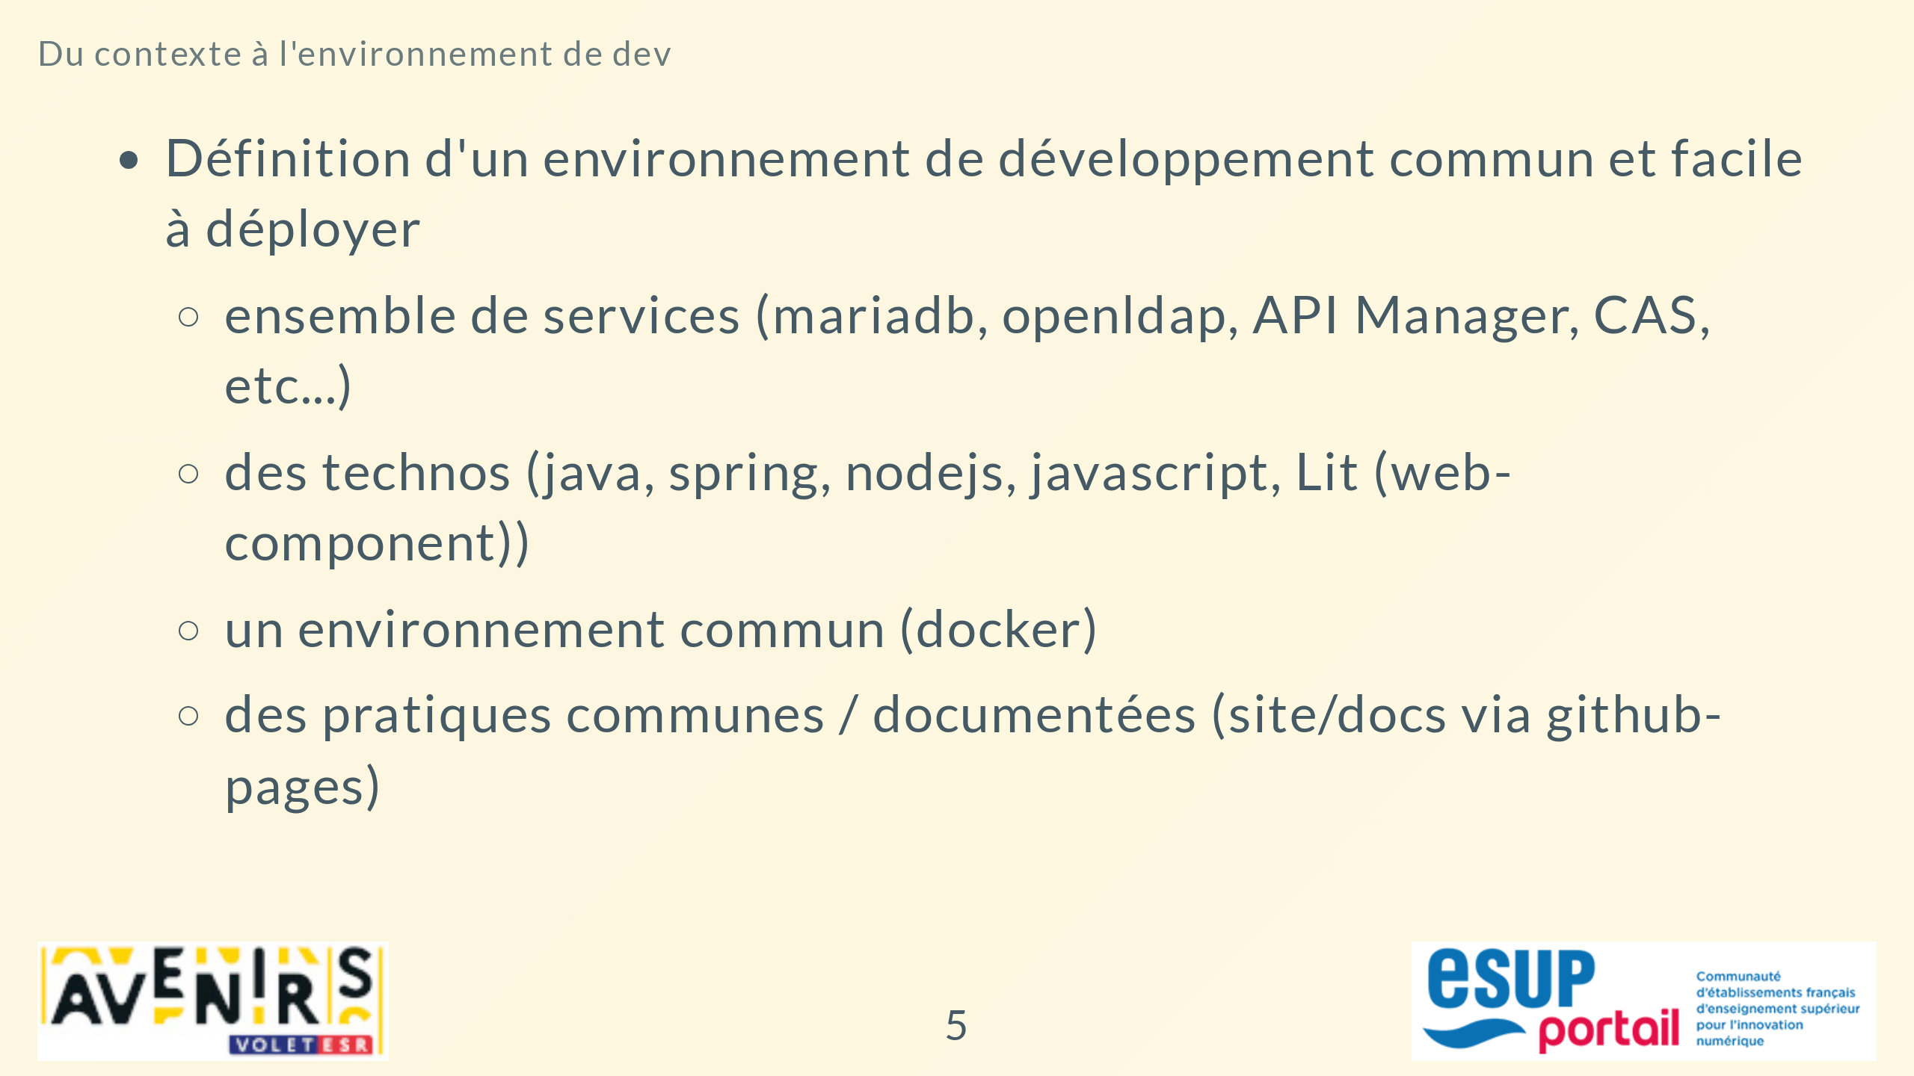

Slide 6
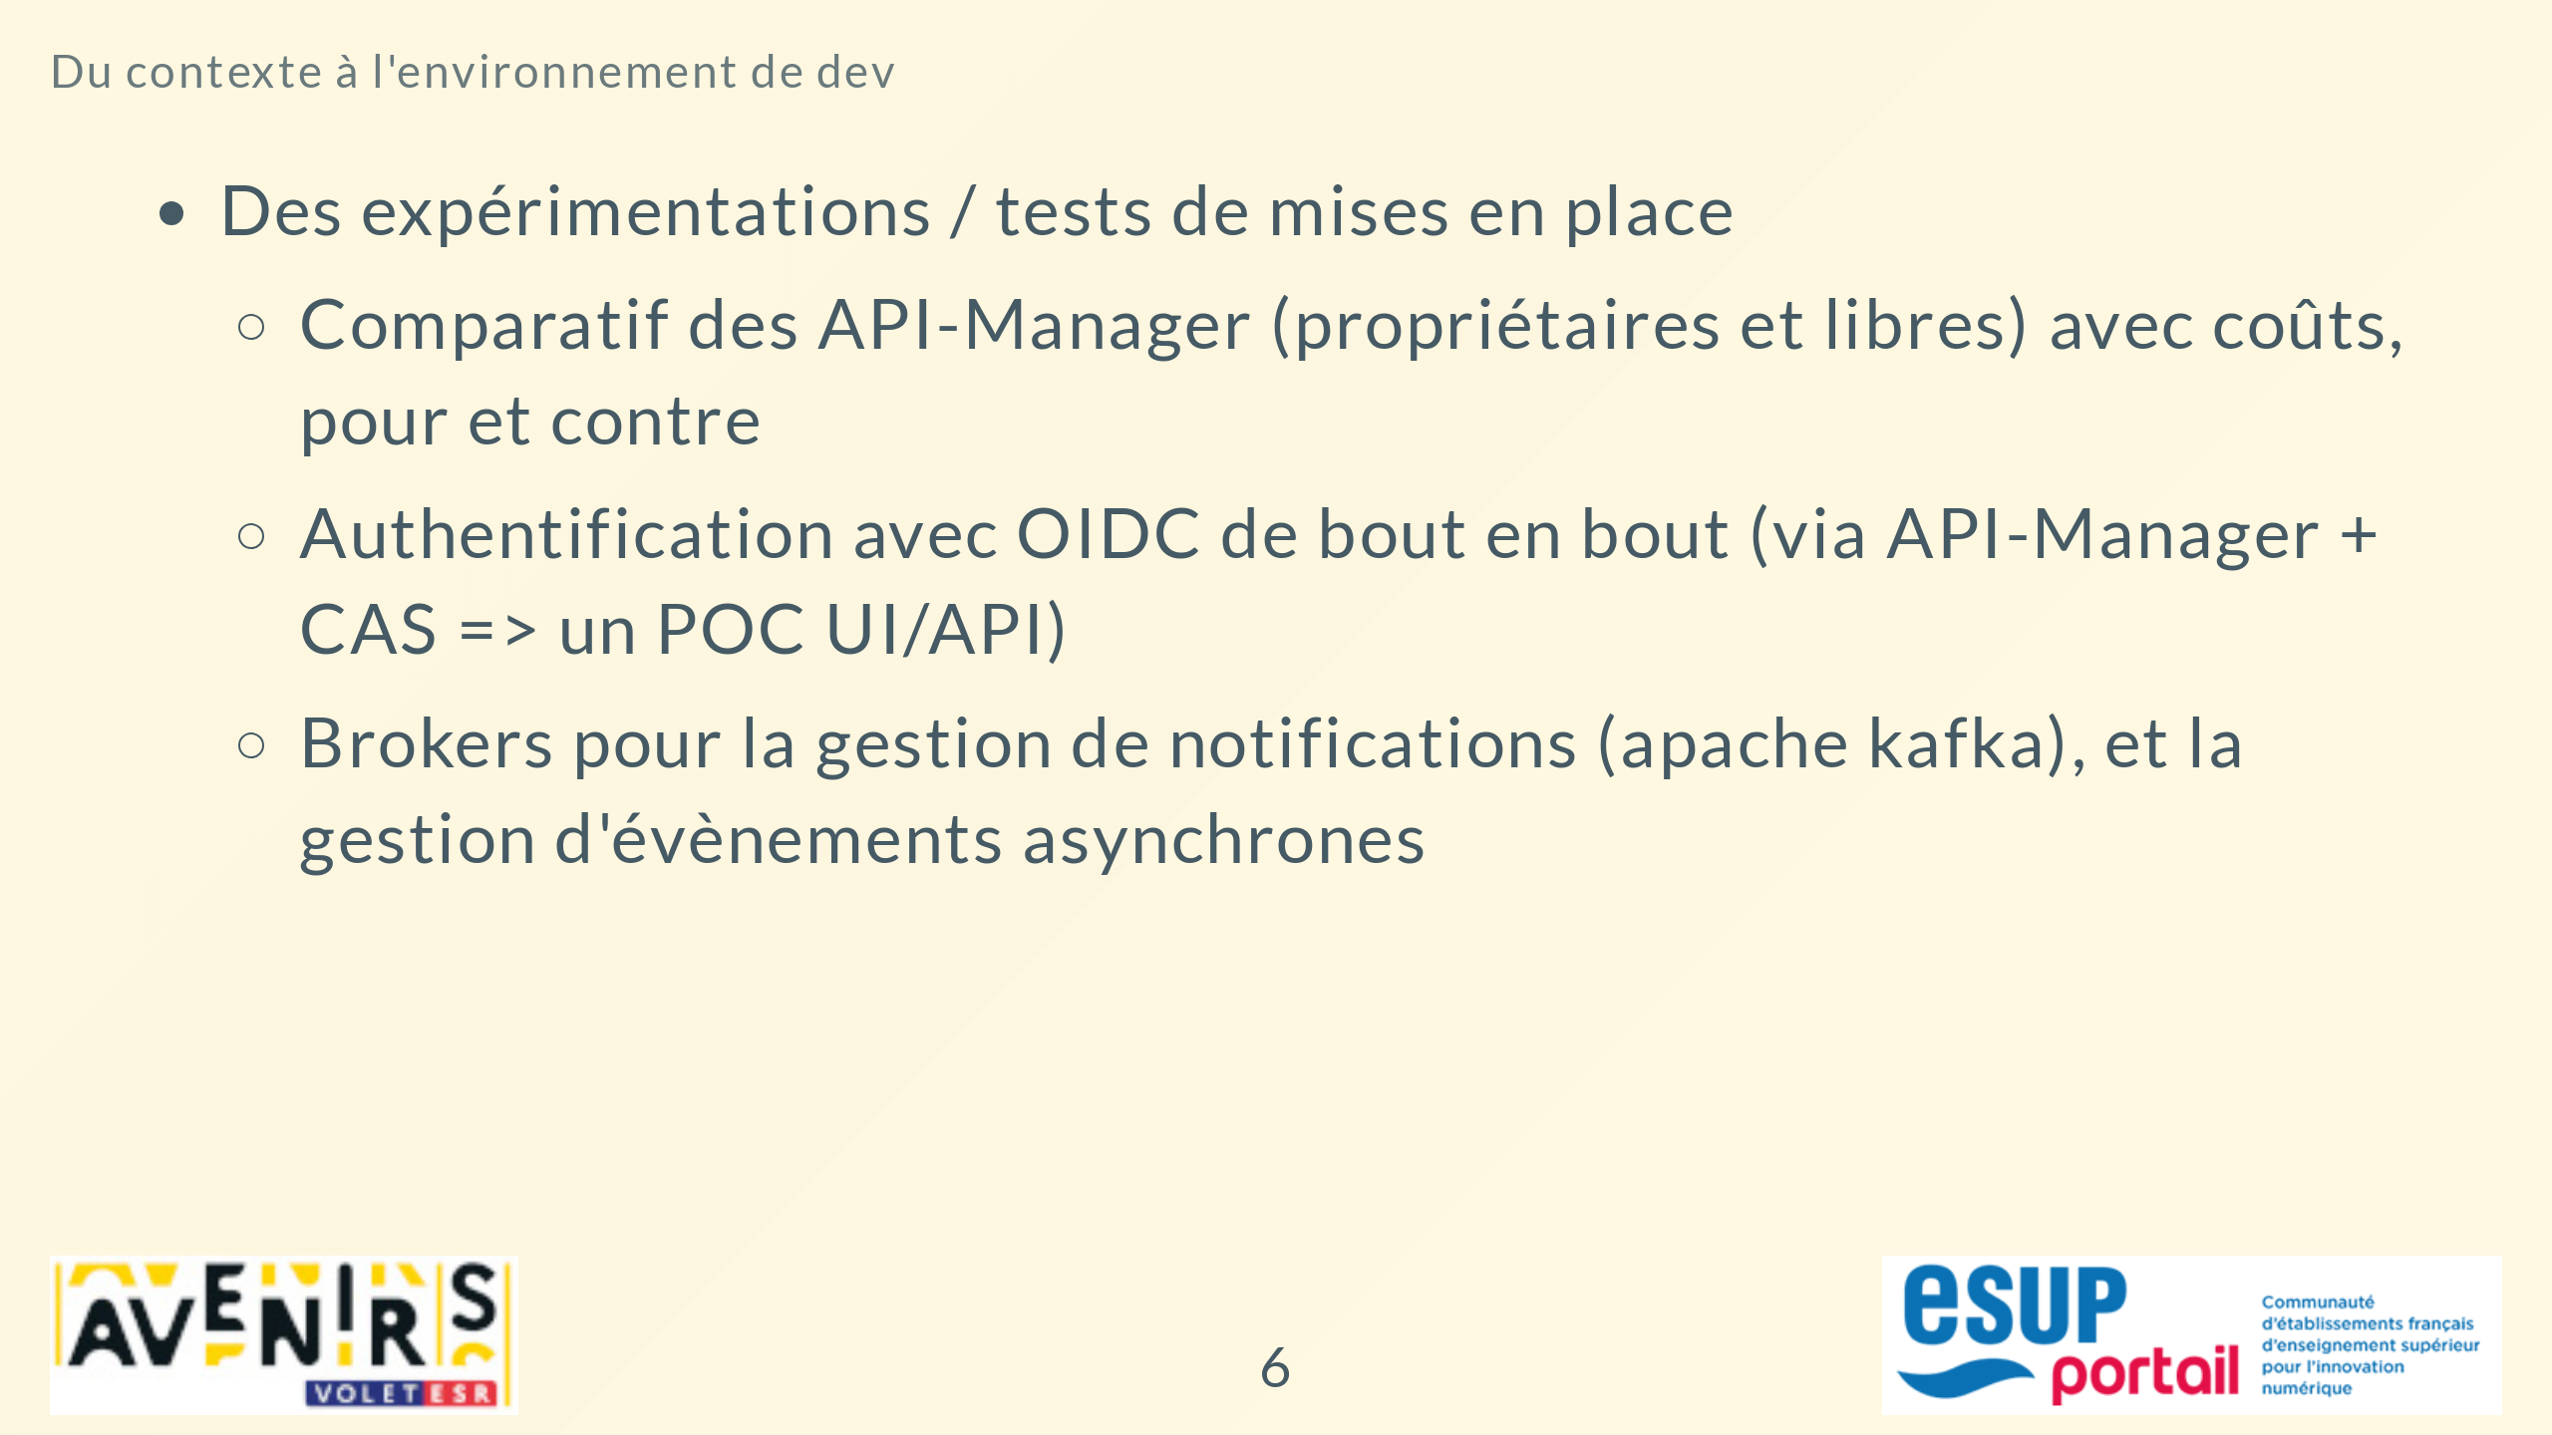

Slide 7
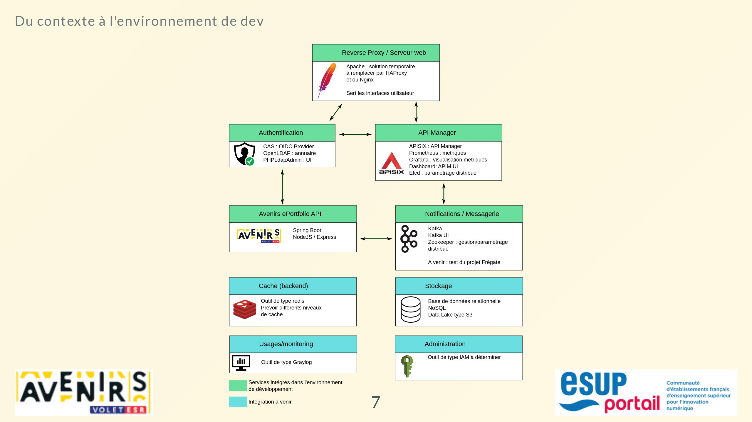

Slide 8


Slide 9


Slide 10


